Slide 1
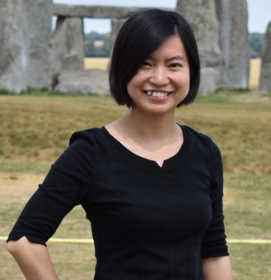

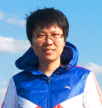
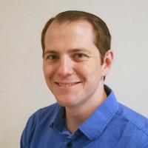
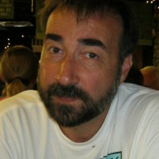
EcoSLIM
Princeton GPU Hackathon
Jun Zhang Hoang Tran Chen Yang
U of Arizona Princeton U Princeton U
Troy Comi Carl Ponder
Princeton U NVIDIA

Slide 2
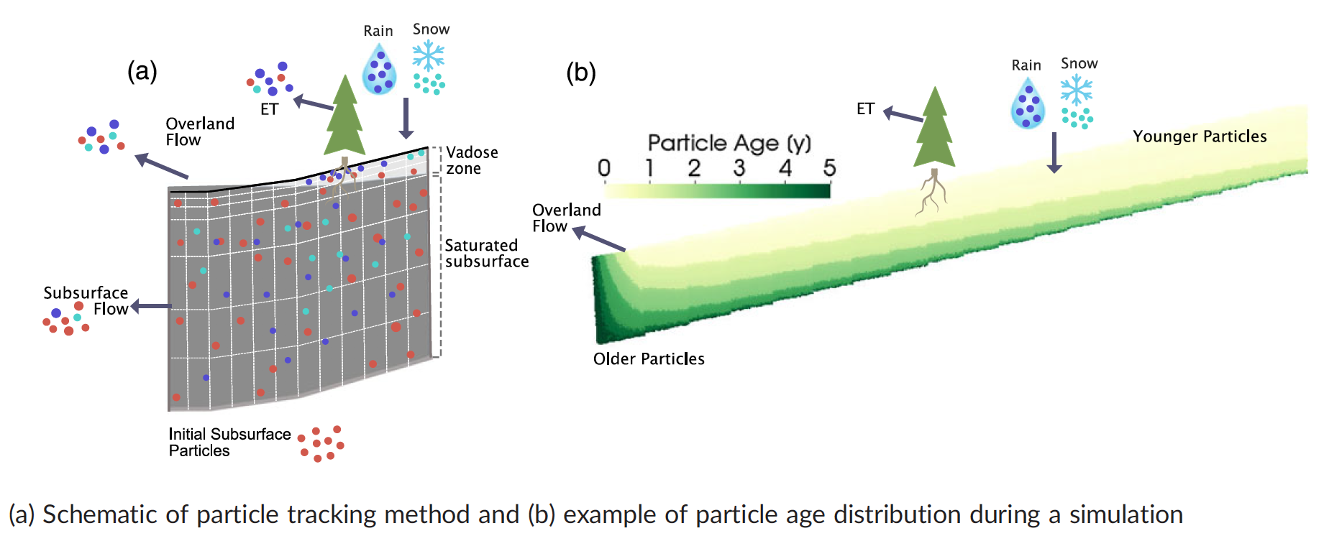
EcoSLIM
A Lagrangian, particle tracking code that simulates advective and diffusive movement of water parcels in subsurface.
Pollock’s method (Pollock, 1988, groundwater) with some new features.
Library: MPI, cuRAND, Thrust
Language: Fortran
GPU port path: CUDA Fortran
Function focused: Sorting inactive particles/
compaction of the particle array

Slide 3
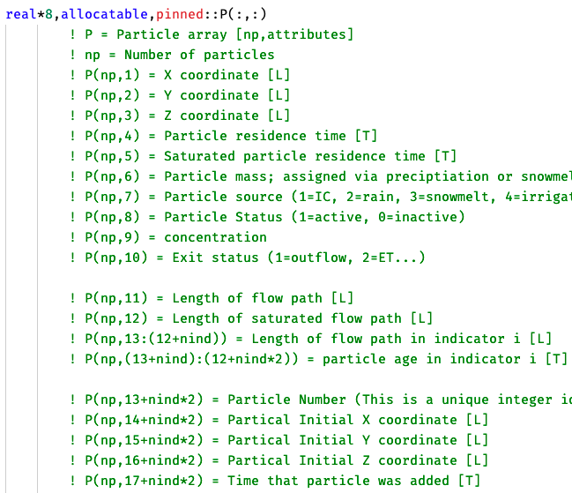
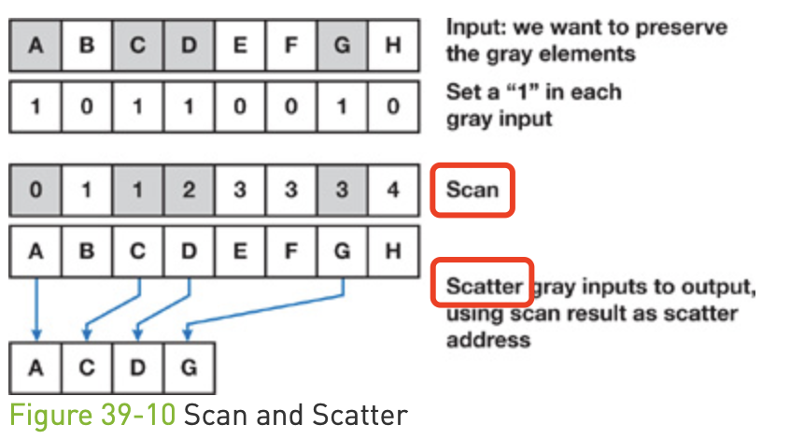
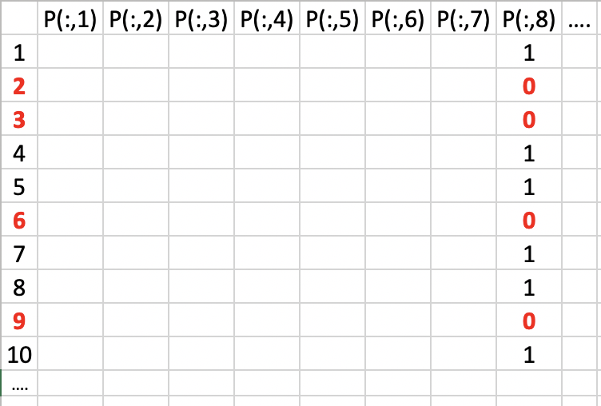
Sorting inactive particles
Some particles will become inactive at the end of each time step. Status of a particle is indicated by P(n,8).
Now we use serial algorithm on CPU to remove the inactive particles (P(n,8)=0), by replacing an inactive particle using an active particle from the bottom of the P array.
We want to realize its parallelization on GPU by using stream compaction.
Particle array with dimension of
n particles × (17+nind*2) attributions

Slide 4
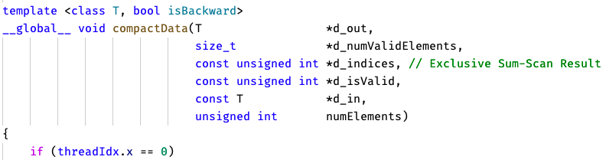
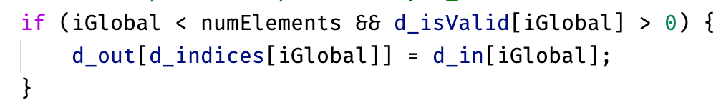
Goals
Scatter in cudpp
1D array
For scan: writing a wrapper to call exclusive_scan in Thrust which is a CUDA C++ template library;
For scatter: modifying the kernel from cudpp to handle 2D particle array P;
For scatter: writing a wrapper to call this CUDA C++ kernel in Fortran; Or probably rewrite it in CUDA Fortran;
Test and profile scan and scatter using restart files generated in previous simulations;
Using cmake, Nsight, etc.

